Slide 1


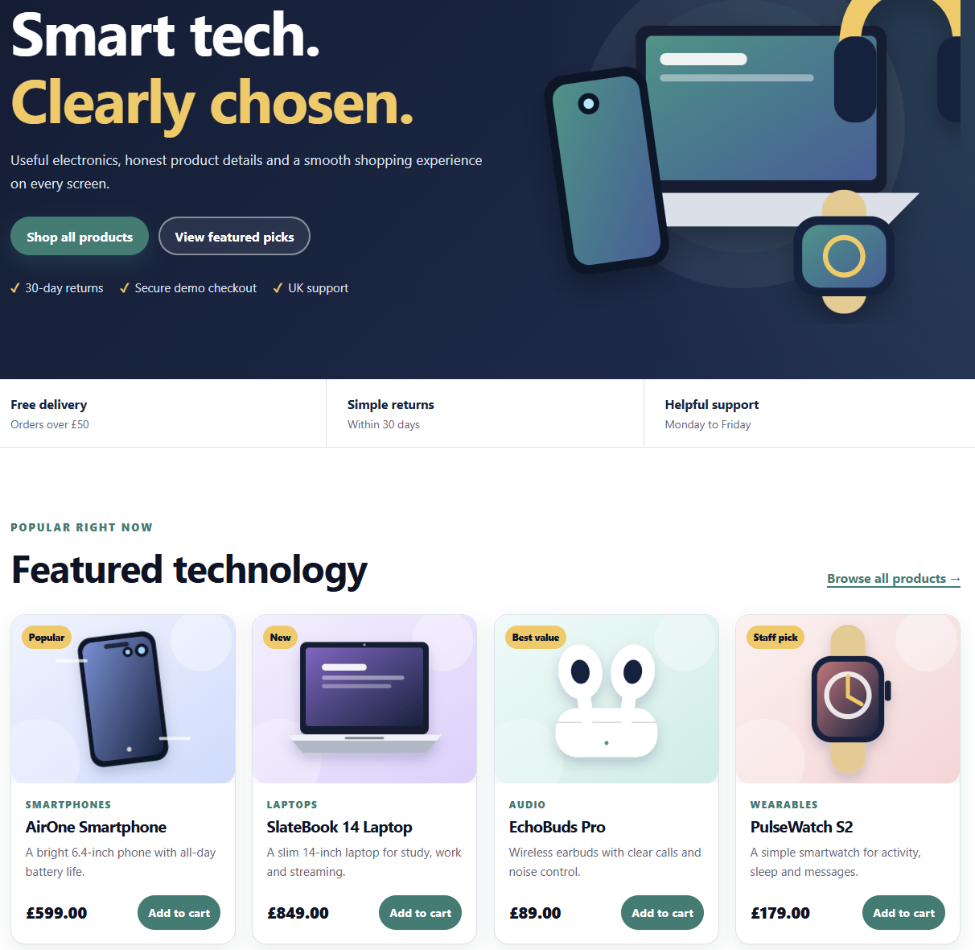
CPU4104 WEB DEVELOPMENT
A responsive electronics store built with HTML, CSS and JavaScript
FARAH ARSLAN
Student project presentation
Notes:
Hello, my name is Farah Arslan. My project is NovaVolt Electronics, a responsive online store for smartphones, laptops and accessories. I created it for CPU4104 using only HTML, CSS and JavaScript. I will show the customer journey, explain the main code simply and describe my testing and accessibility improvements.
[Sources]
- CPU4104_Summative_Assignment.pdf (module brief supplied by the user)
- NovaVolt Electronics project files and locally captured screenshots
[/Sources]

Slide 2
THE BRIEF
02
The project covers the complete front-end shopping journey
6
12
3
customer-facing pages
electronics products
core web technologies
Home, products, detail, cart, about and contact
No backend, framework or external library
Responsive on desktop, tablet and mobile
Designed so I can explain every main feature
FARAH ARSLAN • CPU4104-20C
NOVAVOLT ELECTRONICS
Notes:
The brief asked for a responsive e-commerce website. I included a home page, products page, product detail, cart, about and contact page. There are twelve products. The solution uses only the technologies taught on the module and does not use a database or framework.
[Sources]
- CPU4104_Summative_Assignment.pdf (module brief supplied by the user)
- NovaVolt Electronics project files and locally captured screenshots
[/Sources]

Slide 3
DESIGN CHOICES
03
Clear choices help an everyday shopper move with confidence
Target user
Navy
trust and readable text
A student or everyday shopper who wants useful electronics information without a confusing interface.
Teal
important actions
Pale mint
Trust • clarity • speed
calm content areas
FARAH ARSLAN • CPU4104-20C
NOVAVOLT ELECTRONICS
Notes:
My target user is a student or everyday shopper who wants to compare electronics without a confusing layout. I chose dark navy for trust, teal for important actions and pale backgrounds for contrast. Product names and prices are easy to scan, and button labels are familiar.
[Sources]
- CPU4104_Summative_Assignment.pdf (module brief supplied by the user)
- NovaVolt Electronics project files and locally captured screenshots
[/Sources]

Slide 4
PROJECT STRUCTURE
04
Each technology has one simple job
HTML
CSS
JavaScript
Page structure
Visual design
Interaction
Headings, navigation,
product areas and forms
Colour, spacing, grid
and responsive rules
DOM rendering, filters,
cart and validation
pages / css / js / media / evidence / docs
FARAH ARSLAN • CPU4104-20C
NOVAVOLT ELECTRONICS
Notes:
The project uses separate folders for pages, CSS, JavaScript, images, evidence and documents. HTML provides structure. CSS provides design and responsive rules. JavaScript creates product cards and adds the cart and validation. Keeping these jobs separate made the work easier to understand.
[Sources]
- CPU4104_Summative_Assignment.pdf (module brief supplied by the user)
- NovaVolt Electronics project files and locally captured screenshots
[/Sources]

Slide 5

HOME PAGE
05
The first screen gives the visitor a clear next step
A clear opening
Short value statement
Two main actions
Four featured products
Consistent header and footer
FARAH ARSLAN • CPU4104-20C
NOVAVOLT ELECTRONICS
Notes:
The home page introduces the store with a clear headline and two main actions. Under the hero section it shows four featured products. The header and footer are consistent across the site, so visitors can reach Products or Cart quickly. I would demonstrate the home page here.
[Sources]
- CPU4104_Summative_Assignment.pdf (module brief supplied by the user)
- NovaVolt Electronics project files and locally captured screenshots
[/Sources]

Slide 6
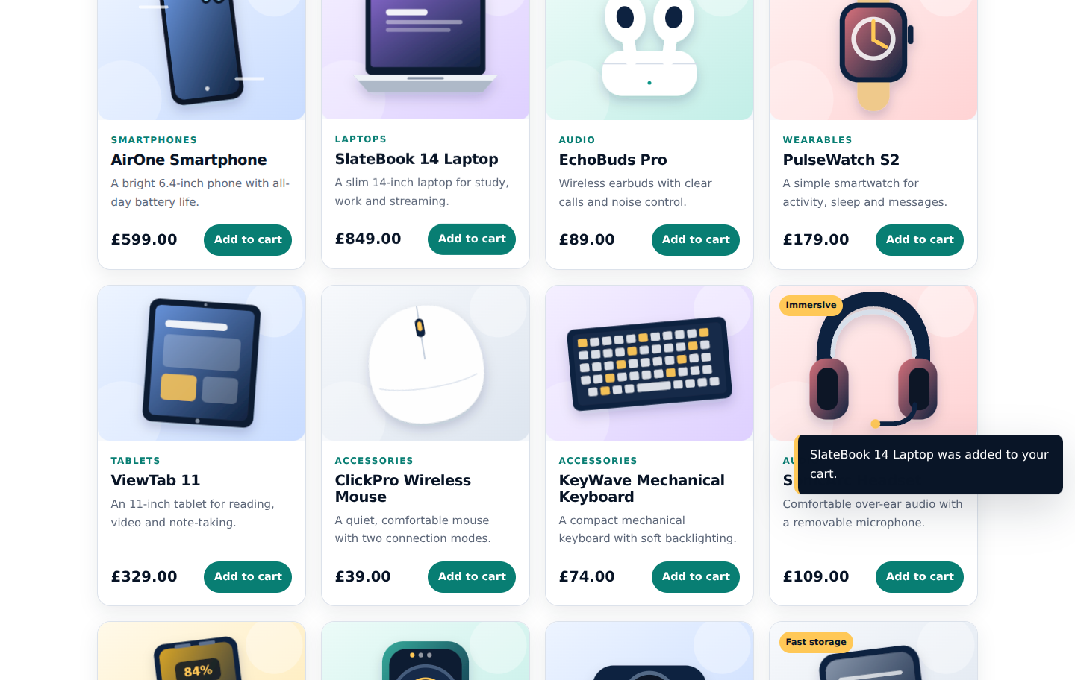
PRODUCT DISCOVERY
06
Search and filtering turn 12 items into a manageable choice
The DOM updates
1
Read the products array
2
Apply search, filter or sort
3
Create the matching cards
FARAH ARSLAN • CPU4104-20C
NOVAVOLT ELECTRONICS
Notes:
The Products page displays twelve items. JavaScript reads a products array and creates each card in the DOM. A user can type in the search box, choose a category or sort by price. Clicking View details opens the selected item and shows its description and feature list.
[Sources]
- CPU4104_Summative_Assignment.pdf (module brief supplied by the user)
- NovaVolt Electronics project files and locally captured screenshots
[/Sources]

Slide 7
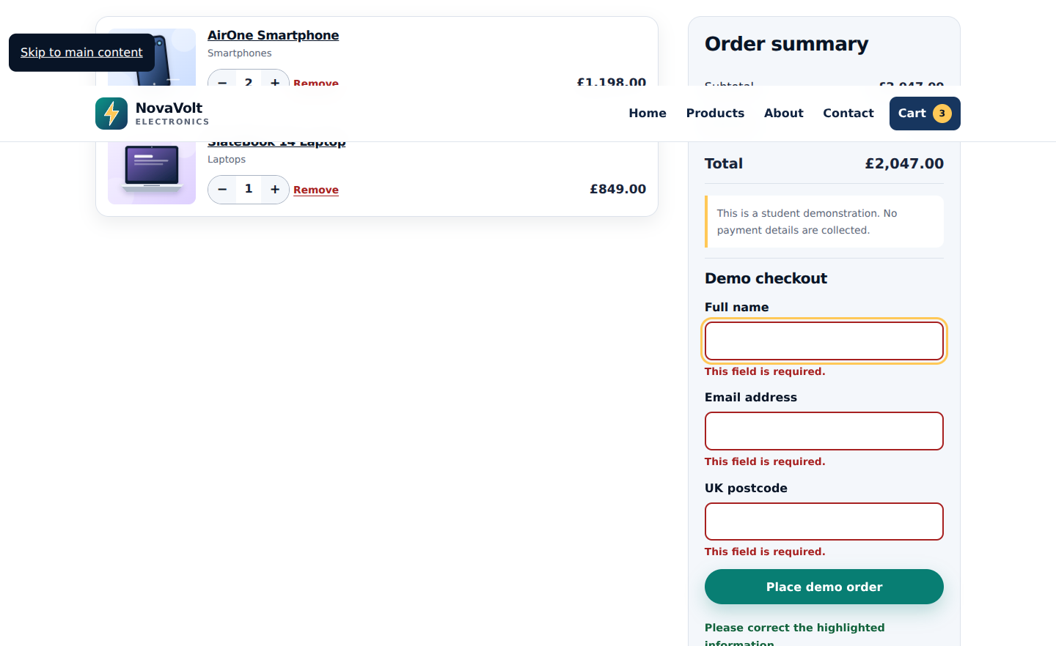
CART FUNCTIONALITY
07
Every cart action immediately recalculates the order
Add
save item
Change
update quantity
Calculate
show total
Stored in localStorage
FARAH ARSLAN • CPU4104-20C
NOVAVOLT ELECTRONICS
Notes:
When Add to cart is clicked, JavaScript saves the product number and quantity in localStorage. The cart remains after refreshing the page. On the cart page, the user can increase, decrease or remove an item. Each action recalculates the subtotal, delivery and total.
[Sources]
- CPU4104_Summative_Assignment.pdf (module brief supplied by the user)
- NovaVolt Electronics project files and locally captured screenshots
[/Sources]

Slide 8
RESPONSIVE DESIGN
08
One content system adapts across three screen sizes
DESKTOP
MOBILE
390 px
Menu button
One-column cards
Stacked controls
No sideways scroll
FARAH ARSLAN • CPU4104-20C
NOVAVOLT ELECTRONICS
Notes:
I tested the design at desktop, tablet and mobile sizes. CSS Grid changes the number of product columns. At phone width, navigation is hidden until the menu button is pressed, and controls stack into one column. I also checked that there is no sideways scrolling.
[Sources]
- CPU4104_Summative_Assignment.pdf (module brief supplied by the user)
- NovaVolt Electronics project files and locally captured screenshots
[/Sources]

Slide 9
ACCESSIBILITY AND SEO
09
Small code choices make the experience clearer and easier to find
ACCESSIBILITY
SEO
Colour contrast
Page titles
Dark readable text and controls
A unique title for every page
Labels and errors
Descriptions
Every field explains what is needed
A useful search summary
Keyboard access
Open Graph
Skip link and visible focus
Clear information when shared
FARAH ARSLAN • CPU4104-20C
NOVAVOLT ELECTRONICS
Notes:
My main accessibility improvements were stronger colour contrast and clearer form labels and errors. I also added a skip link, visible keyboard focus, alternative text, semantic landmarks and a reduced-motion rule. For SEO, each page has its own title and description, plus Open Graph information.
[Sources]
- CPU4104_Summative_Assignment.pdf (module brief supplied by the user)
- NovaVolt Electronics project files and locally captured screenshots
[/Sources]

Slide 10
TESTING
10
The important customer actions were checked, not just the appearance
✓
6 pages open
✓
12 products render
✓
Search and filters work
✓
Details match product
✓
Cart totals update
✓
Forms show errors
✓
3 viewport widths
✓
Keyboard focus visible
FARAH ARSLAN • CPU4104-20C
NOVAVOLT ELECTRONICS
Notes:
I tested navigation, twelve product cards, search, filters, product details, adding items, changing quantities, totals and both forms. I also tested three screen widths. The code uses small named functions, for example one reads the cart, another saves it and another calculates totals.
[Sources]
- CPU4104_Summative_Assignment.pdf (module brief supplied by the user)
- NovaVolt Electronics project files and locally captured screenshots
[/Sources]

Slide 11
WHAT I LEARNED
The three technologies work best when each one has a clear job.
Biggest challenge
My solution
Next step
Keeping the cart correct across different pages.
One localStorage cart and small reusable functions.
A real database, login and secure payment system.
NovaVolt meets the required front-end customer journey—and I can explain how it works.
Notes:
The project taught me how HTML, CSS and JavaScript work together. The hardest part was keeping cart information correct on different pages. Using localStorage and reusable functions solved this. In future I would add a database, secure login and payment system, but those are outside this assignment.
[Sources]
- CPU4104_Summative_Assignment.pdf (module brief supplied by the user)
- NovaVolt Electronics project files and locally captured screenshots
[/Sources]

